Slide 1
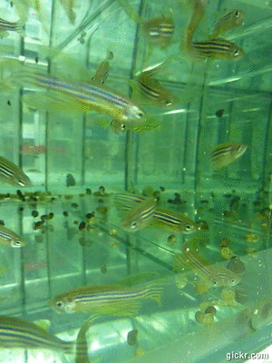
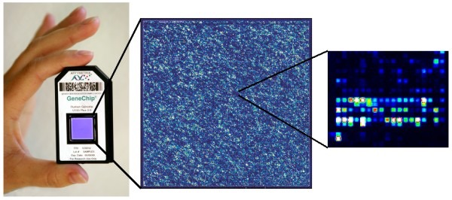
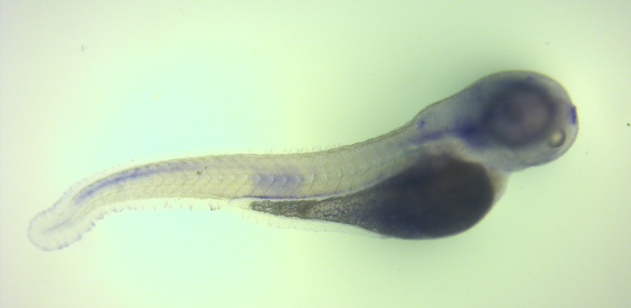
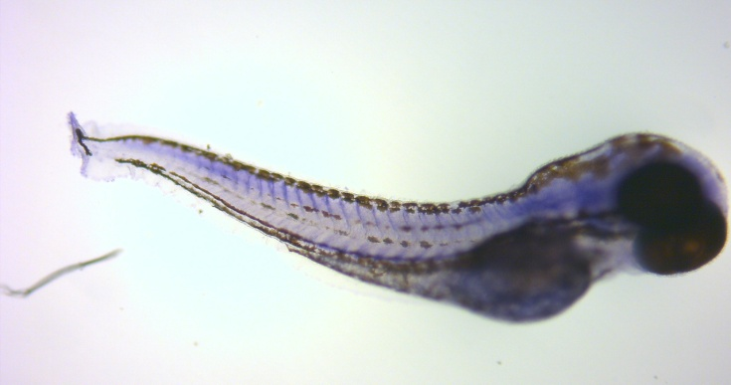
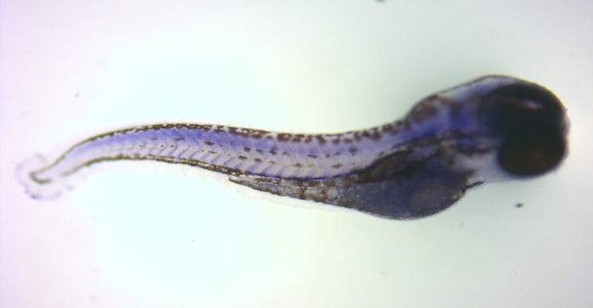
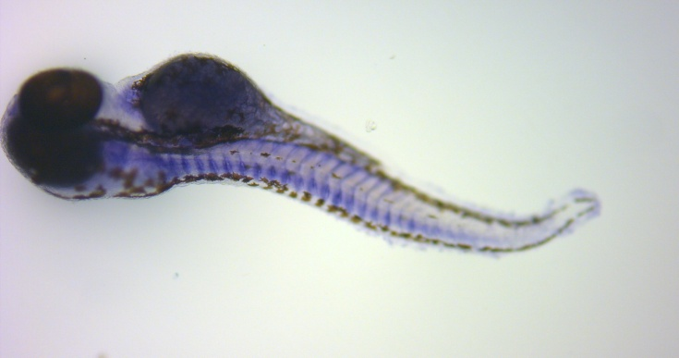
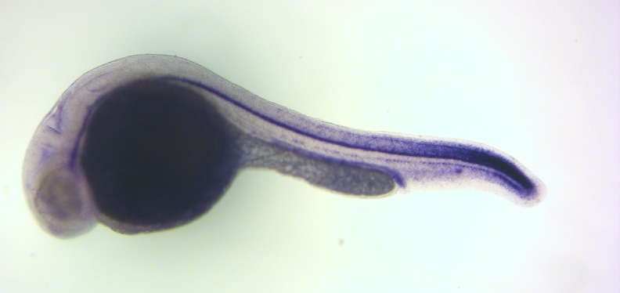
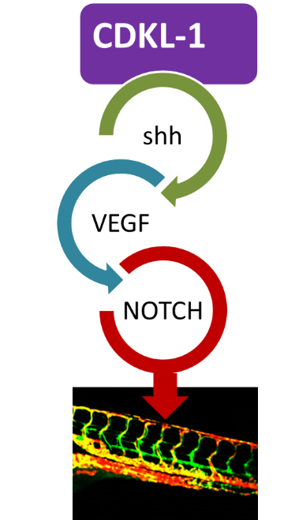
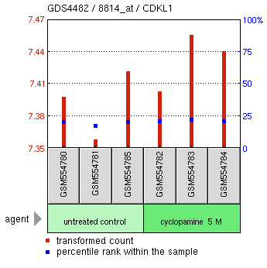
Unravelling the genetic mechanisms behind Cardiovascular Disease using the Zebrafish as a model organism
vhl +
vhl -
vhl +
vhl ^{+/+} (4/19)
vhl ^{+/-} (5/19)
vhl -
vhl ^{+/-} (5/19)
vhl ^{-/-} (5/19)
CDKL1
CDKL1
CDKL1
CONTROL-MO
zcdkl1-MO
zcdkl1-MO
+ mRNA

