Slide 1
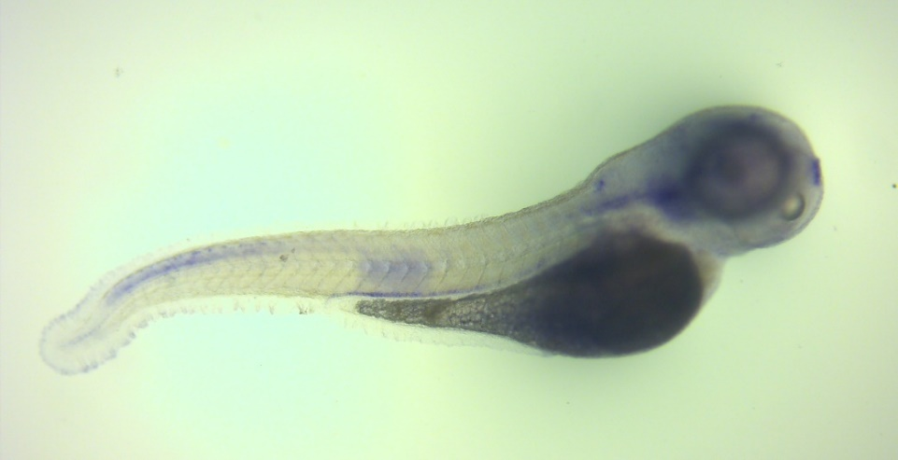
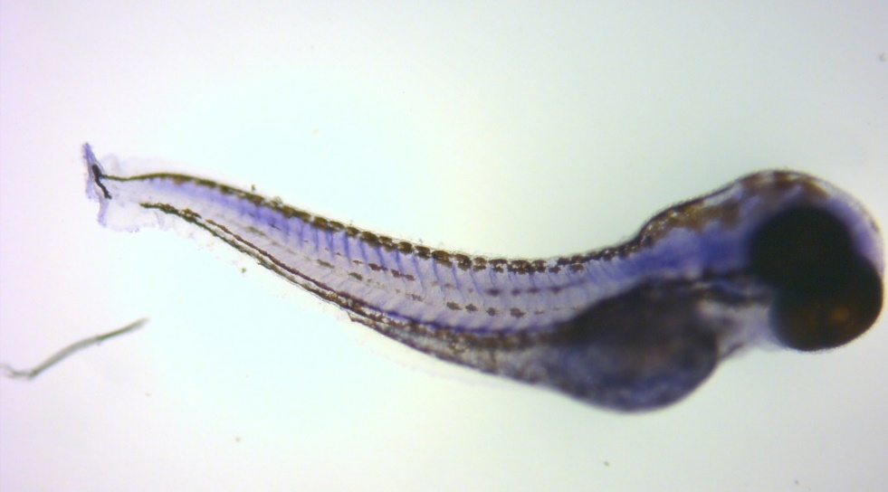
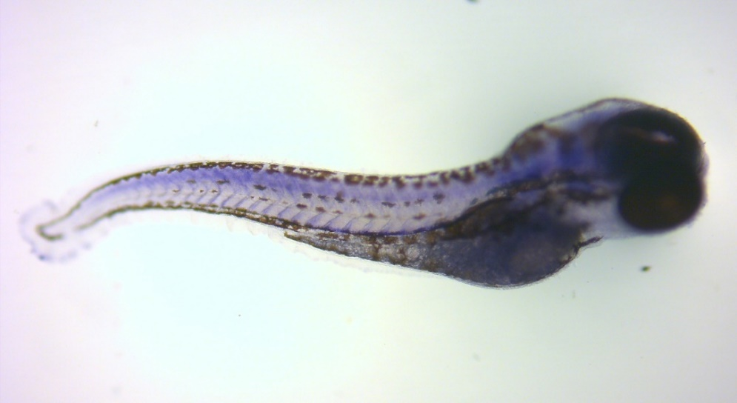
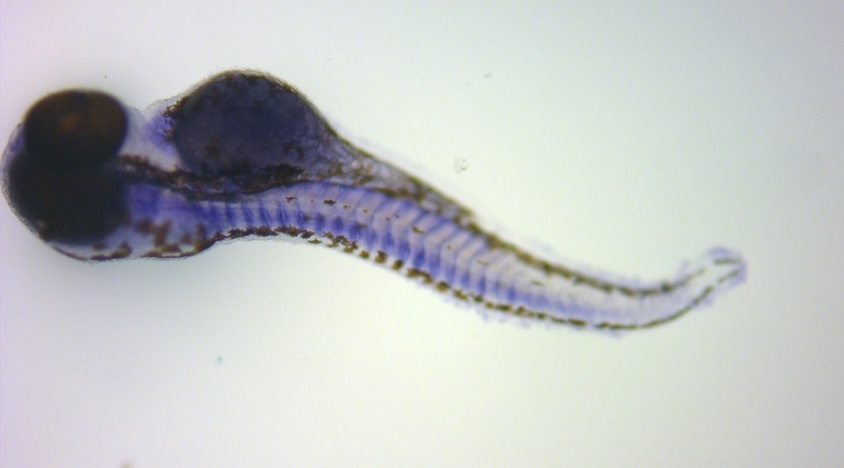
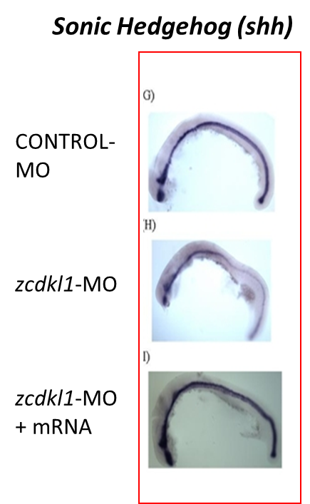
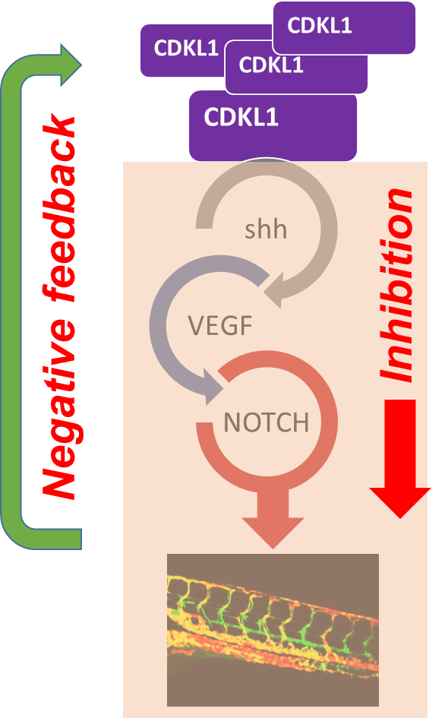
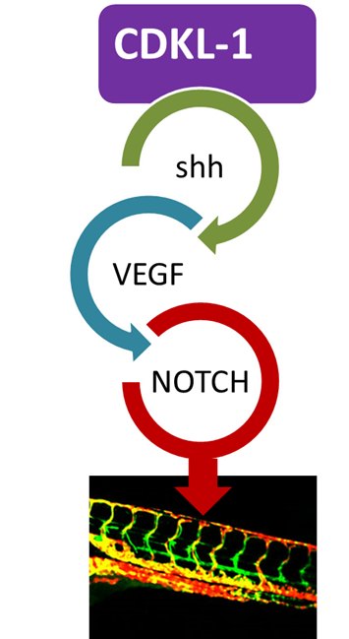
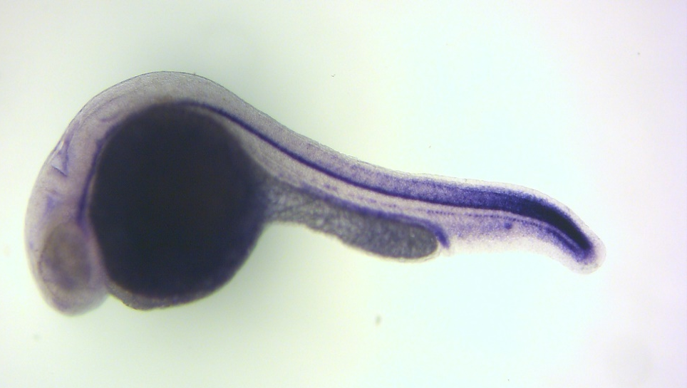
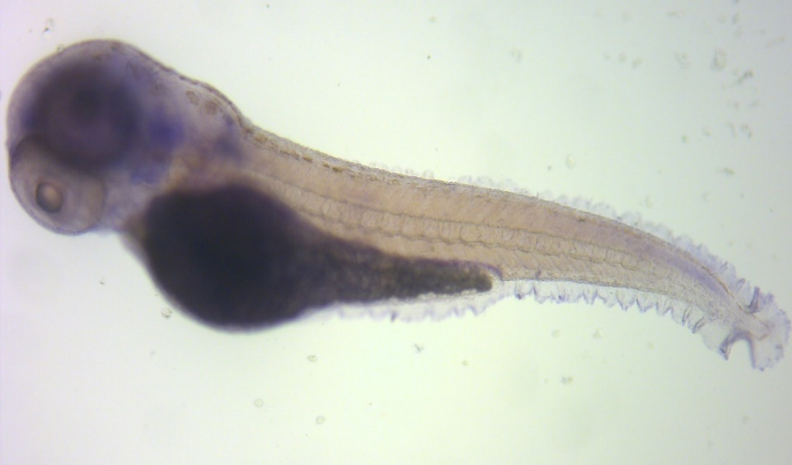
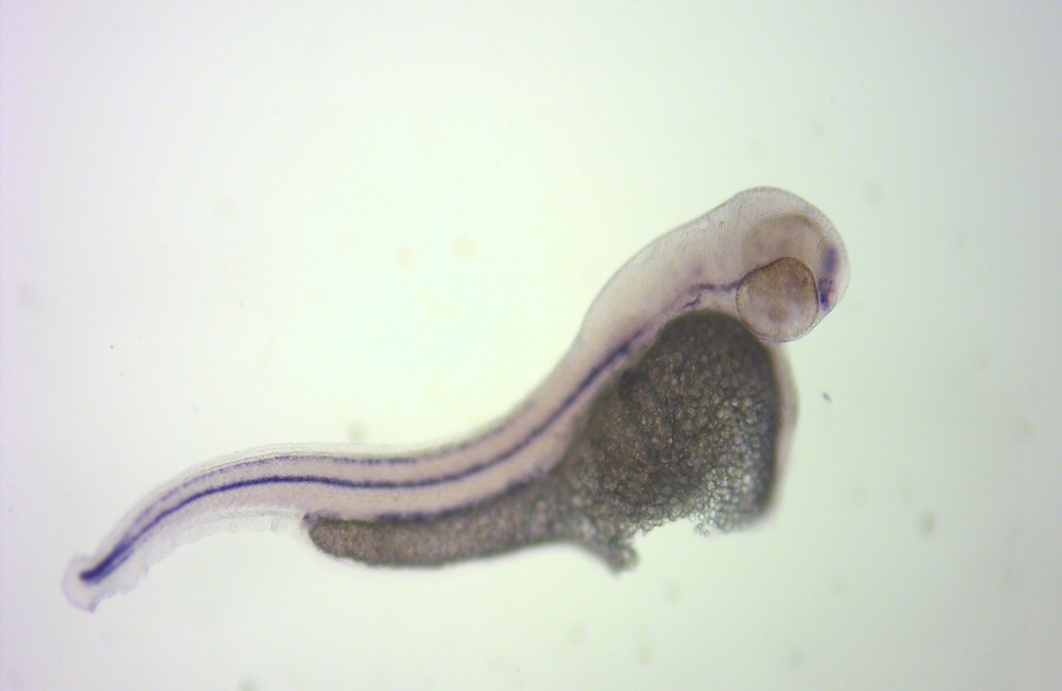
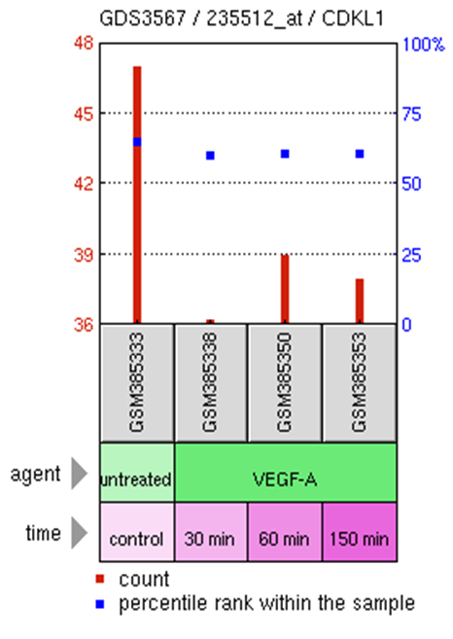
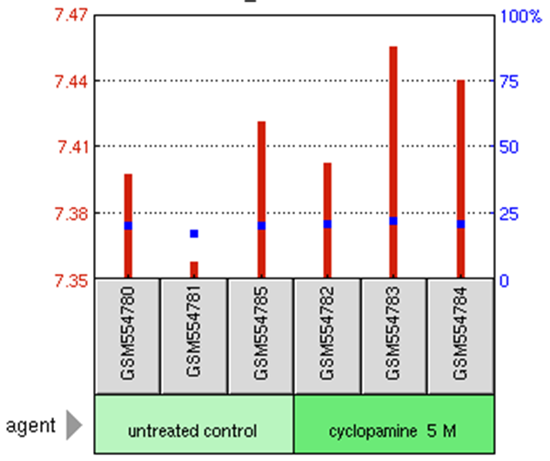
Unravelling the genetic mechanisms behind Cardiovascular Disease
using the Zebrafish as a model organism
Post-16 students Tapton School, 2012– present, A. Bradbury *, N. Harris*, N. Logan*, M. Milo † ,T. Chico †,
*Tapton School, †Sheffield; Bateson Centre, University of Sheffield
Overview
Myocardial infarction (heart attack) is responsible for many deaths in the UK. Whilst we understand how lifestyle choices impact on this disease the molecular mechanisms behind its cause are still poorly understood. Here we report our research, in collaboration with the University of Sheffield, on the identification of a previously unknown gene (CDKL-1) and its role in this disease!
Aims
Screen patients with Atherosclerosis to Identify novel genes involved in Heart Disease.
Use the Zebrafish model organism to indicate the role of the genes in development of blood vessels.
Background information
The blood of Heart Attack patients at the Northern General Hospital Sheffield, was analysed using Affymetrix gene chip technology to determine differences in genetic markers. Genes are instructions for making the proteins which control our biology. This screen identified 82 genes as having significant differences in how they were being expressed in response to a myocardial infarction.
To investigate the function of these genes we used the developing Zebrafish embryos to identify which tissues they were present in.
Methodology
In-situ hybridization: Specific probes were used to highlight tissues expressing genes of interest.
Genome Expression Omnibus (GEO): was used to determine genetic pathways.
Results
CDKL-1 is upregulated for 30 days after a heart attack (affymetrix analysis, data not shown)
CDKL-1 localized expression in Hypochord (Figure 1) a tissue which develops blood vessels.
CDKL-1 has elevated expression in vhl mutant embryos which develop more blood vessels (Figure 2).
Literature review suggests CDKL-1 signals for blood vessel development through Sonic hedgehog pathway (Figure 3).
GEO searches corroborate our hypothesis, through a negative feedback mechanism.
v
Conclusion
This research provides firm evidence for the role of CDKL-1 in blood vessel development. Our recent work has been to repeat GEO data experimentally, using drug inhibition of downstream genes of CDKL-1.
N
A
V
vhl ^{+/+} (4/19)
vhl ^{+/-} (5/19)
MB
N
vhl ^{+/+}
Fig. 2
vhl ^{+/-} (5/19)
vhl ^{-/-} (5/19)
Fig. 3
Hsu et al. 2011
24 hpf
48 hpf
CDKL-1
Expression
Figure 4.
GEO analysis shows
Inhibition of Shh upregulates CDKL-1 in human endothelial cells, supplementation of VEGF results in down regulation of CDKL-1.
Fig. 1
72 hpf
48hpf Tricaine
Figure 1. Zebrafish embryos (1-2 day old) stained for expression of CDKL-1. Blue stain indicates expression, red arrow-hypochord, black arrow-Notochord, green arrow- prenephric duct. Expression along hypochord regresses from head to tail as the embryos develop.
Fig. 4

