Slide 1
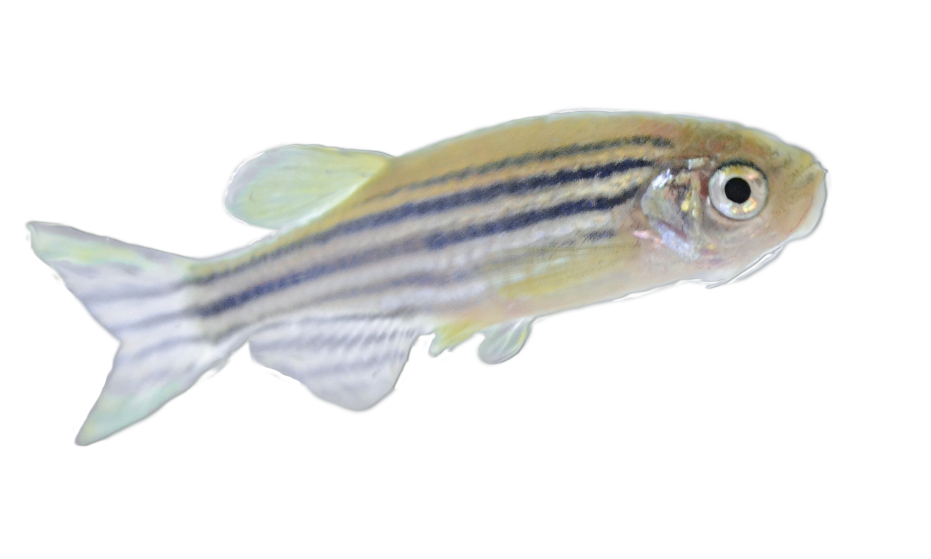
Does the novel gene CDKL1 have a role in blood vessel development?
@TaptonZfish

Slide 2
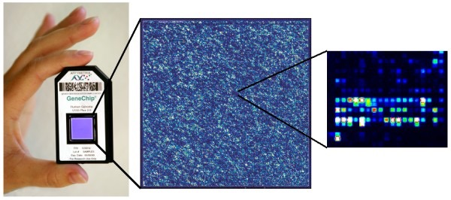
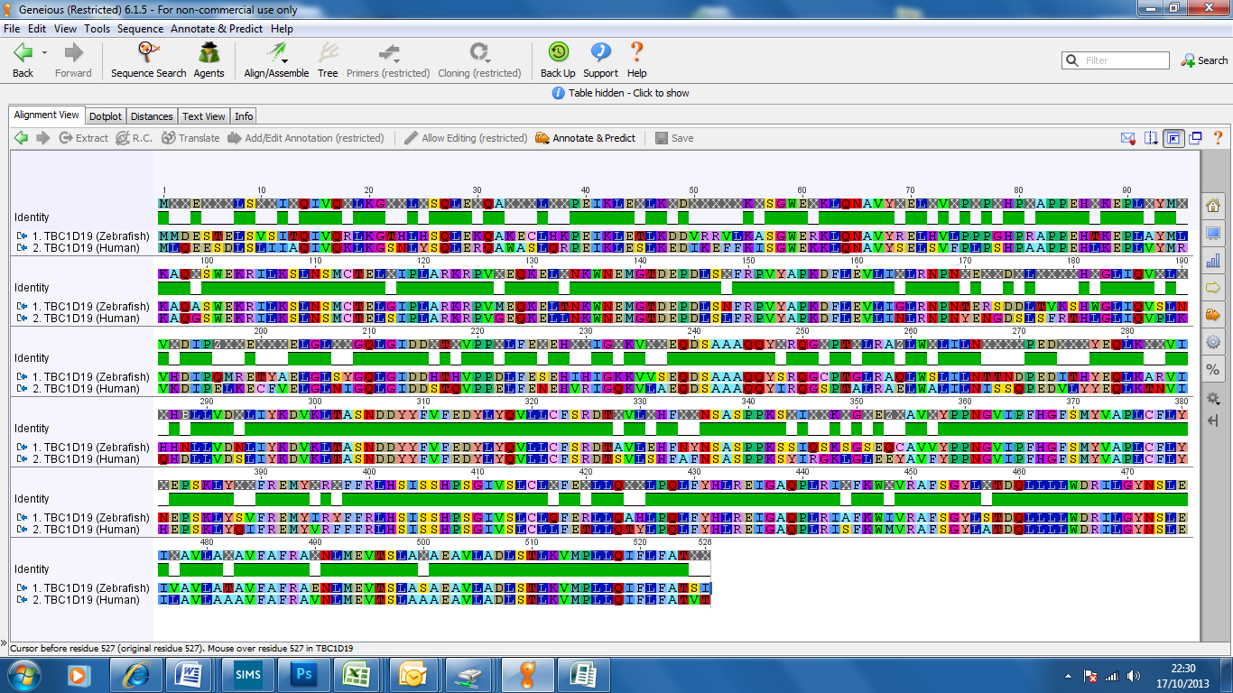
THE STUDY
Notes:
A clinical study was conducted at the University of Sheffield in which a group of patients presented at hospital with complaints of chest pains. All these patients were found to have atherosclerosis, a hardening of the arteries caused by fatty deposits, however only half the patients had suffered a heart attack. The other half of the patients then acted as a control group.
Over a 90 day period, gene expression patterns of both groups were analysed using AFFymetrix gene chips. This was done by extracting messenger RNA from blood samples, labelling the RNA fluorescently and hybridising it to the gene chip. After scanning, the two data sets were compared. Genes showing increased or decreased expression, relative to the control, were highlighted and statistically analysed by Dr Marta Milo. Although 82 genes were found to have significant differences in expression, CDKL1 was the most differentially expressed, persisting for 30 days.

Slide 3
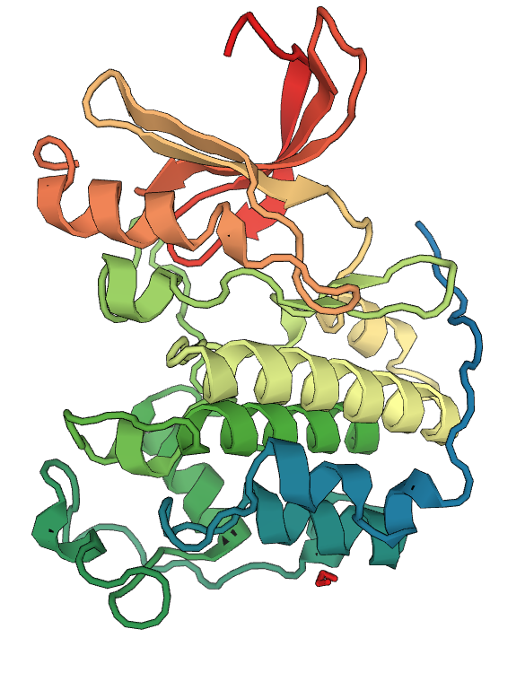
THE GENE
Human CDK2
Human CDKL-1
Notes:
Our gene has been classed as Cyclin dependent “like” as it contains the conserved domain for binding cyclin “KKIARLE” as well as a kinase domain. Its structure is also shown to be similar to human CDK2. It is a novel CDKL-1 gene as no function has been assigned to it.
Clinical study done by the University of Sheffield compared the gene expression patterns of 2 groups of patients complaining of heart pain. The first group persisted to have a heart attack, whilst the second group (the control) did not, but did have atherosclerosis.
The gene expression patterns of these patients were monitored over a 90 day period using AFFymetrix gene chips. Messenger RNA was extracted from blood samples, fluorescently labelled and then hybridised to the chip. After scanning, the data of the on the amounts of gene expression was compared and analysed for any differences in the 2 groups.
Only the genes that showed an increase or decrease in expression were highlighted which was then sorted and statistically analysed by Dr Marta Milo. 82 genes were found to have significant differences in their gene expression, but CDKL1 was the most differentially expressed, persisting for 30 days.
At Tapton we used emsembl, an open source genetic database to identify zebrafish orthologs from the protein sequence alignment we performed. These orthologs had a high percentage identity which means they are more likely to perform the same function as CDKL-1 due to its high homology.

Slide 4
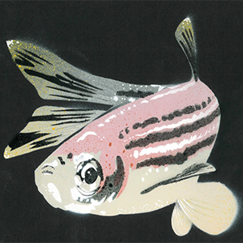
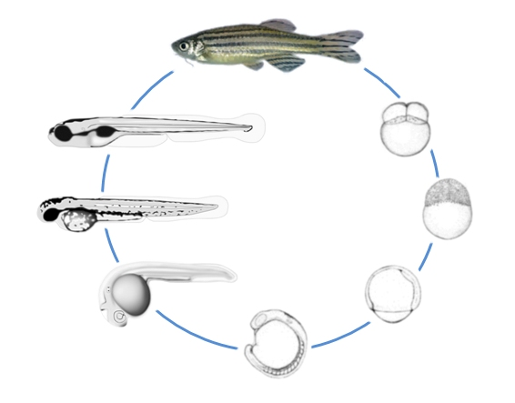
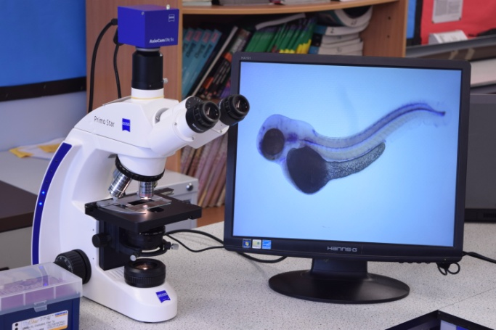
THE MODEL ORGANISM
Notes:
There are several reasons why we decided to use zebrafish as our model organism.
They have many advantageous characteristics:
Each transparent embryo develops rapidly and at the same rate, so the development of the dorsal aorta (main blood vessel) is clearly visible.
Their rapid growth rate means that early embryos are large enough to inject, but small enough to still be suitable for analytical techniques such as ‘in situ hybridisation’.
Zebrafish are fertilised externally, so more can be obtained from the same parent.
The whole experiment is carried out on live embryos.
If they die then observations can still be carried out, because they remain intact.
Alignment of protein sequences between zebrafish and humans reveals over 70% identity between these species, therefore inferences are more likely to be correct.
Some experiments studying the cardiovascular system involve stopping blood flow. It is therefore essential that the effects of blood flow are separate from the effects of hypoxia. Zebrafish embryos can survive in hypoxic conditions, as they are small enough for oxygen diffusion.
Zebrafish embryos are still attached to the yolk sack, meaning that they aren’t free feeding. This makes ethics approval easier to obtain.
Zebra fish breeding programmes are cheaper than those in mammals for example, and the specimens take up less laboratory space.
Dr Tim Chico’s lab at The University of Sheffield can provide us with all of the mutants of this species, as his ongoing research uses zebra fish to investigate blood vessel development.

Slide 5
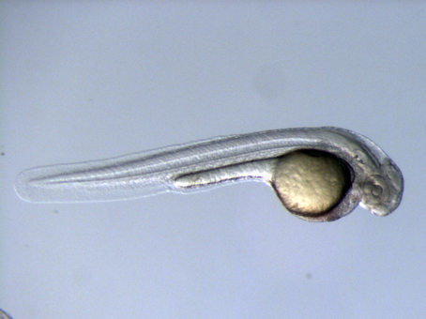
THE METHOD
enzyme
DIG
NUCLEUS

Slide 6
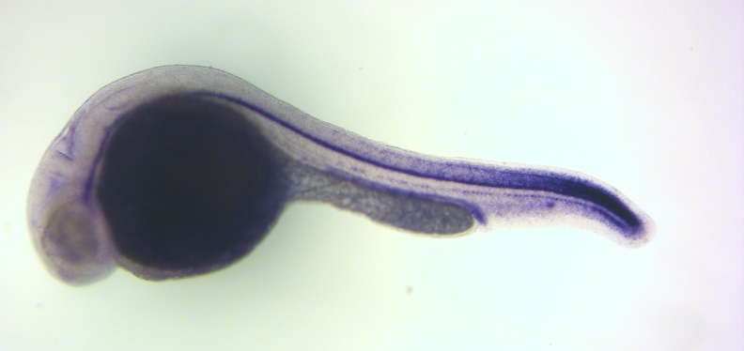
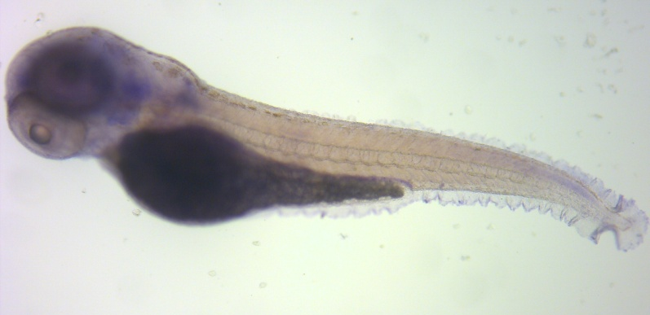
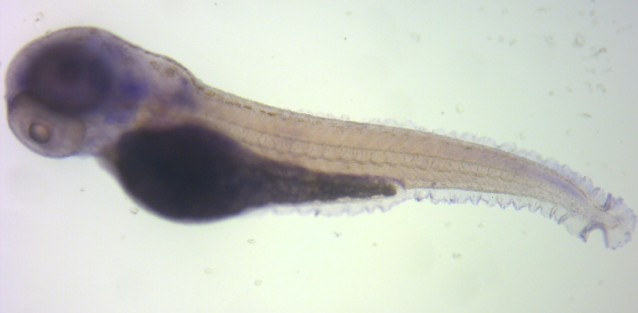
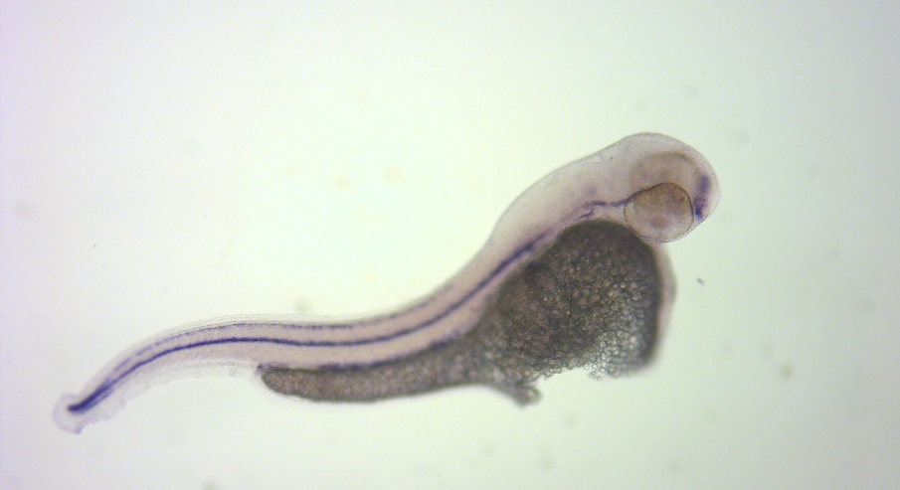
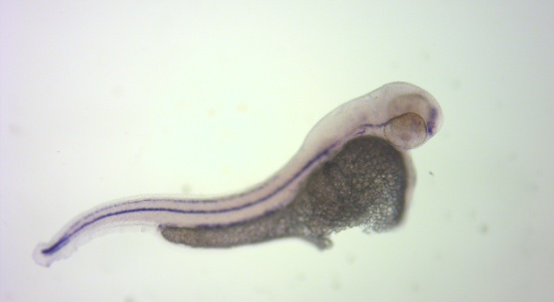
CDKL-1 expressed in the hypochord
Notochord
24 hpf
24 hpf
Hypochord
48 hpf
48 hpf
72 hpf
24 hpf
24 hpf
Fig. 3
72 hpf
48hpf Tricaine
Fig. 3
72 hpf
48hpf Tricaine

Slide 7
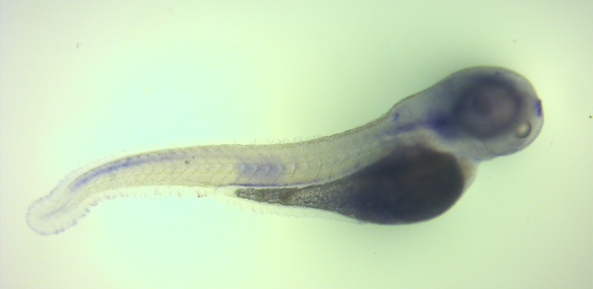
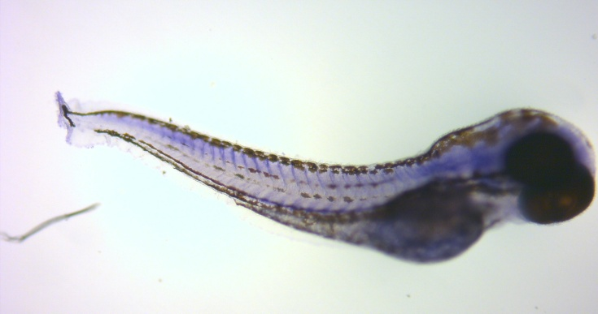
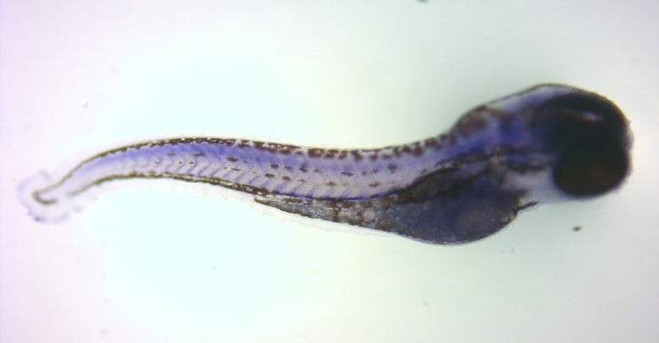
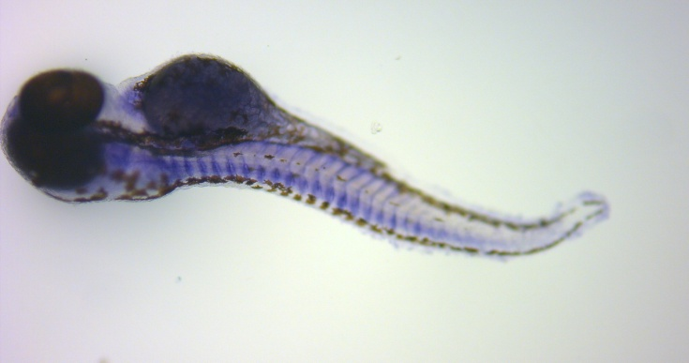
CDKL-1 expression in embryos with more blood vessels
vhl +
vhl -
Notochord
vhl +
Dorsal aorta
vhl ^{+/+} (4/19)
vhl ^{+/-} (5/19)
Posterior Cardinal vein
vhl -
vhl ^{+/-} (5/19)
vhl ^{-/-} (5/19)
Homozygous vhl mutant
vhl ^{-/-}
^{transverse}

Slide 8
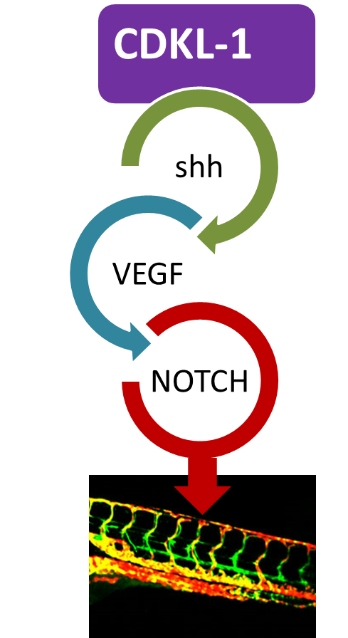
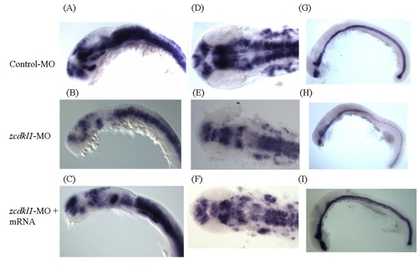
Developing a Hypothesis:
Literature Review
Neurogenin Sonic Hedgehog (shh)
CONTROL-MO
zcdkl1-MO
zcdkl1-MO
+ mRNA

Slide 9
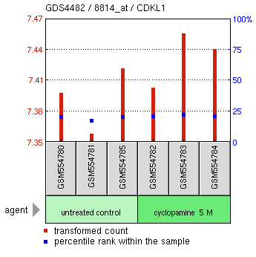
Negative feedback Hypothesis:
CDKL1
CDKL1
CDKL1
CDKL1
shh
VEGF
NOTCH
cyclopamine
Genome expression omnibus data
CDKL 1

Slide 10
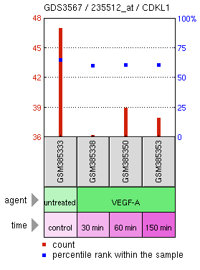
Developing a Hypothesis:
Genome expression omnibus data
shh
VEGF
NOTCH
CDKL-1
CDKL1

Slide 11
Can we confirm the hypothesis experimentally?
Pharmacological Inhibition of VEGF Signaling
CDKL-1
DMSO control 6hr from 24hpf
shh
VEGF
NOTCH
AV951
6hr treatment AV951 from 24hpf

Slide 12
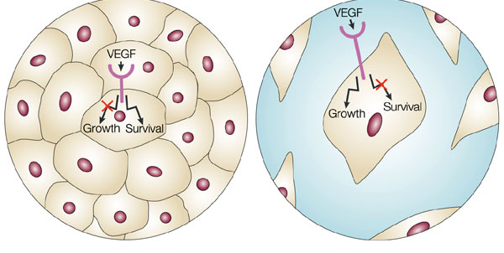
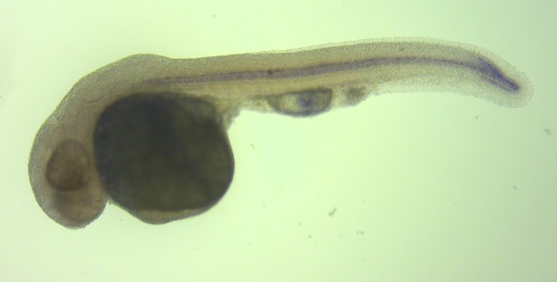
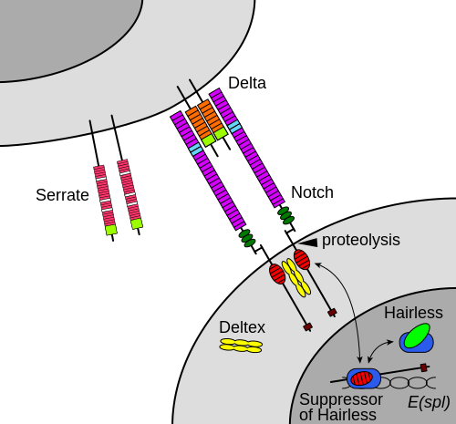
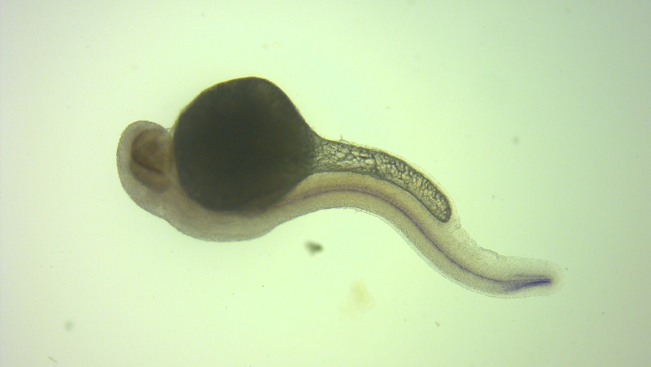
Pharmacological Inhibition of NOTCH Signaling
Pharmacological Inhibition of NOTCH with DAPT
DMSO control 6hr from 24hpf
CDKL-1
shh
VEGF
NOTCH
6hr treatment DAPT from 24hpf

Slide 13
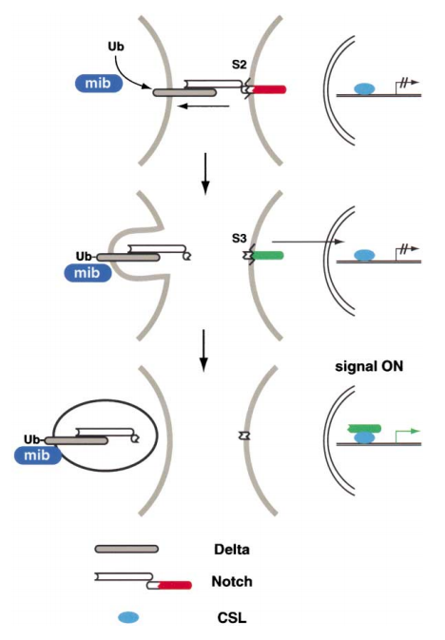
Genetic inhibition of NOTCH signalling
Genetic Inhibition of NOTCH
Wildtype 24hpf
Mindbomb Mutant 24hpf

Slide 14
FUTURE WORK
Investigate Shh inhibition on CDKL1 expression pattern
Further repeats of the VEGF and NOTCH pharmacological inhibition but with termination of the staining upon onset of Hyperchord staining.
Re-develop hypothesis in the light of the Mindbomb results
CDKL-1
shh
VEGF
NOTCH

Slide 15
Acknowledgements
Dr Tim Chico
Dr Marta Milo
Karen Plant
Professor Matthew Holley
Tapton Students: 2012/13/14/15/16
Nicou Nassehzideh (Summer student)
Dr Harris
Mr Bradbury
Miss Logan

