Slide 1
How to use a bioinformatics website!
http://www.ensembl.org/index.html

Slide 2
Insert your gene name here.
Search in all species and then select appropriate gene from next page!
Click link

Slide 3
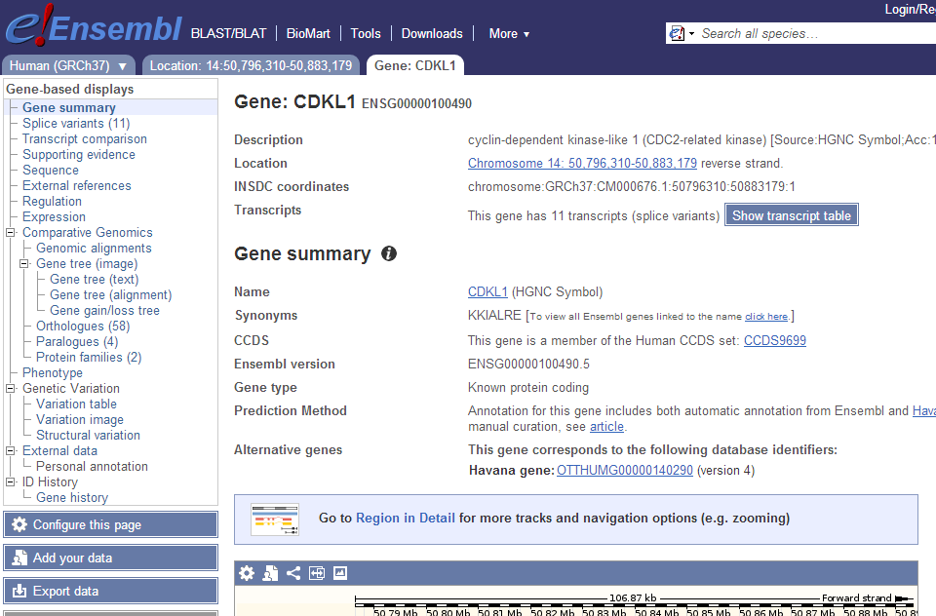
Resultant page:
2 useful links but feel free to explore!
Takes you to gene symbol report.
Here you can retrieve nucleotide and protein sequence data (slide 4)
Orthologues
Versions of this gene in other species (slide 5)
Is the Zebrafish gene similar to the human gene?
Look at the surrounding region in humans and the zebrafish
Do a protein alignment-
Should we proceed?

Slide 4
Gene Symbol Report
Scroll down for DNA and protein seq’

Slide 5
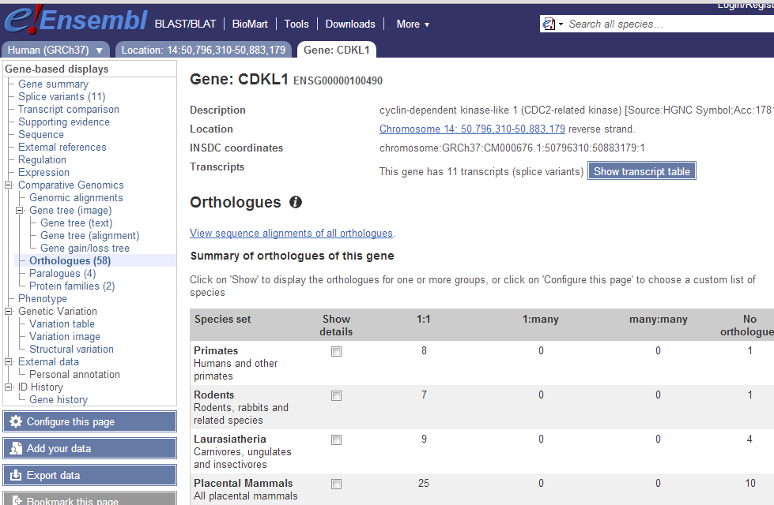
Is the Zebrafish gene similar to the human gene?
Look at the surrounding region in humans and the zebrafish
Do a protein alignment-
Should we proceed?
Orthologues
Scroll down for Danio rerio
Zebrafish
Slide 6
Slide 7
Slide 8

Slide 6
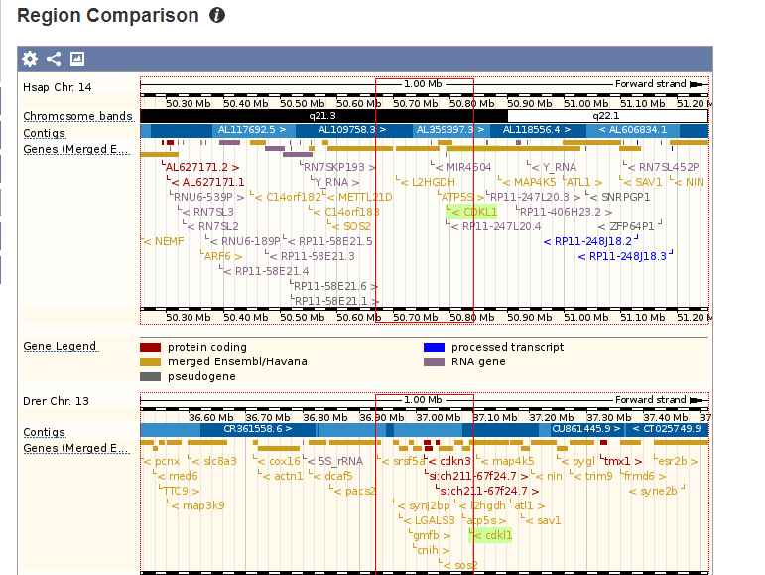
Region comparison
In this example similarities between human and zebrafish are apparent!
This means that this region of the genome has not changed in the millions of years of evolutionary separation and that this gene is most likely conserved and hence important.
Export image and paste into PPT document, saved with the gene name followed your name.
Eg) CDLK1-Ojackson
Save it in your area and upload this onto the Padlet page.

Slide 7
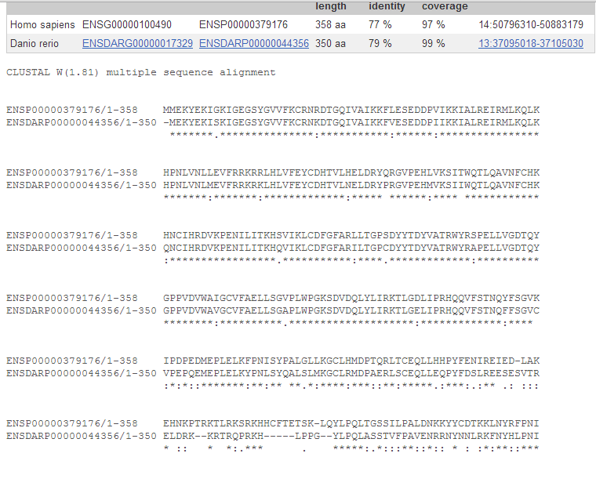
Sequence Alignment (protein)
Navigate back to the orthologues page and click Protein alignment
In this example there is between 77-79% identity
Take a screen shot and paste this into your PPT.

